Slide 1


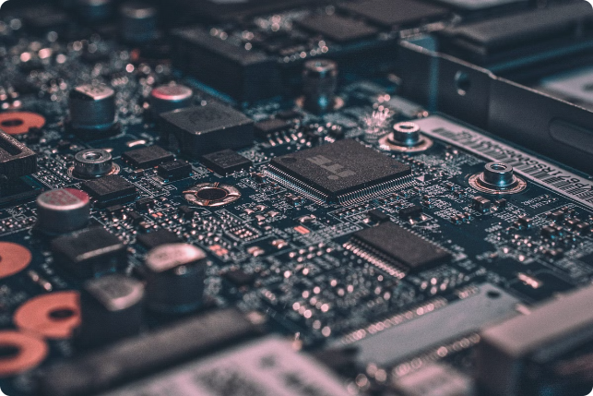


Introduction to Embedded Systems Engineering
Embedded systems are specialized computing devices designed to perform specific functions within a larger system. This field combines software and hardware engineering to create innovative solutions for a wide range of industries, from consumer electronics to industrial automation.
swaraj kumar | LinkedIn
@crosXplatform

Slide 2
Embedded Software Engineer
Key Skills
Job Responsibilities
Career Outlook
Proficiency in programming languages like C, C++, and assembly. Experience with real-time operating systems, firmware development, and software optimization.
Develop and maintain embedded software, write device drivers, and optimize code for performance and efficiency.
High demand for embedded software engineers as the Internet of Things (IoT) and smart devices continue to grow.

Slide 3

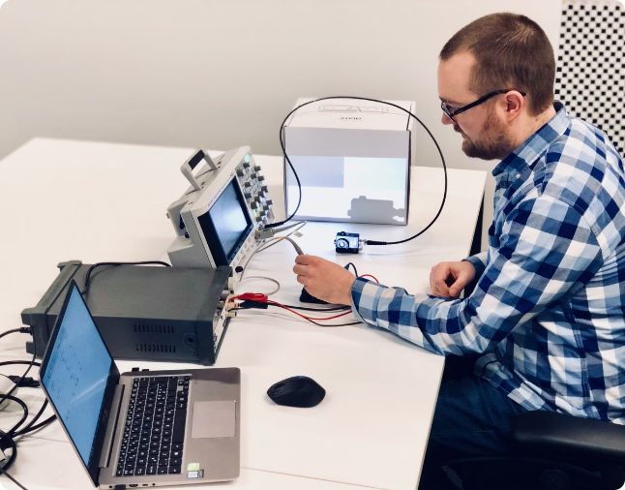
Embedded Hardware Engineer
1
Circuit Design
Design and develop hardware components such as microcontrollers, sensors, and power management circuits.
2
System Integration
Integrate hardware with software to create complete embedded systems.
3
Prototyping and Testing
Build and test prototypes to ensure reliable and efficient hardware performance.

Slide 4
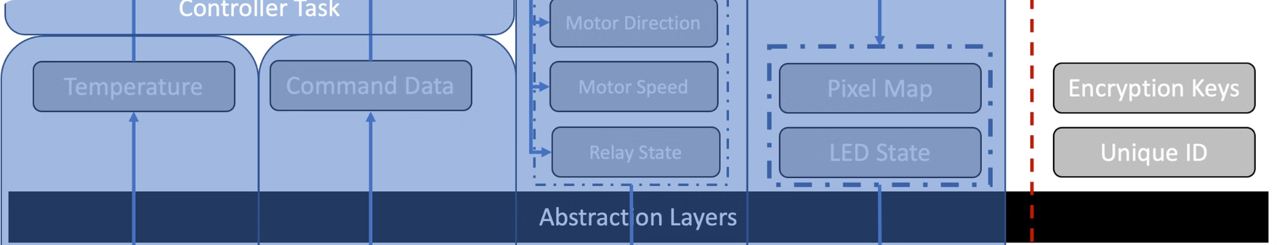
Embedded Systems Architect
System Design
Project Management
Innovation
Responsible for the overall design and architecture of embedded systems, considering factors such as performance, power consumption, and cost.
Coordinate the efforts of software and hardware teams to ensure the successful completion of embedded systems projects.
Develop new and innovative solutions to complex embedded systems challenges, leveraging emerging technologies.

Slide 5

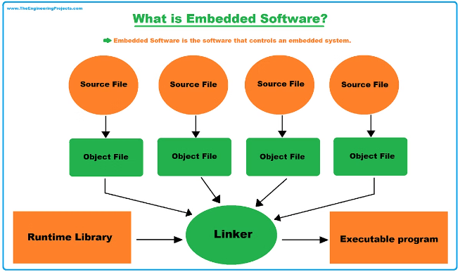
Embedded Systems Analyst
Data Analysis
Collect and analyze data from embedded systems to identify performance issues and optimization opportunities.
Requirements Gathering
Work closely with stakeholders to understand their needs and translate them into technical requirements.
System Evaluation
Assess the effectiveness and efficiency of existing embedded systems and recommend improvements.

Slide 6
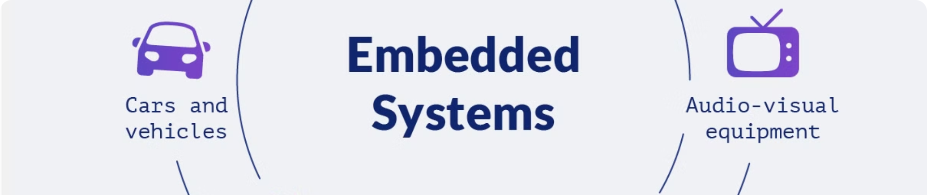



Embedded Systems Technician
Maintenance
Installation
Testing
Perform regular maintenance and troubleshoot issues with embedded systems.
Install and configure embedded systems in various environments.
Conduct tests to ensure the proper functioning of embedded systems.

Slide 7

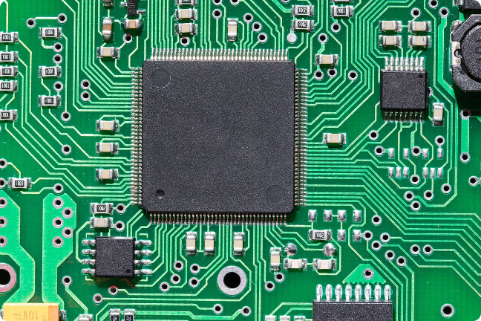



Microcontroller Design Engineer
Microcontroller Selection
Choose the appropriate microcontroller based on the system requirements.
Peripheral Integration
Integrate sensors, communication interfaces, and other peripherals with the microcontroller.
Firmware Development
Design and implement the firmware that controls the microcontroller's operations.

Slide 8

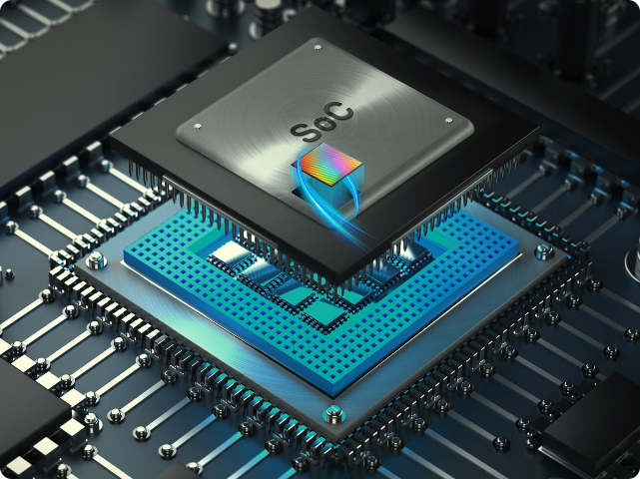
FPGA Design Engineer
1
Architecture Design
Determine the FPGA architecture and resource allocation to meet system requirements.
2
HDL Coding
Write and optimize hardware description language (HDL) code for the FPGA design.
3
Verification and Testing
Thoroughly test the FPGA design to ensure its functionality and performance.

Slide 9
Embedded Systems Programmer
Low-level Programming
Real-time Operating Systems
Software Optimization
Proficiency in programming languages like C, C++, and assembly for embedded systems.
Ability to optimize software for performance, power efficiency, and resource utilization.
Experience with real-time operating systems (RTOS) and their integration with embedded hardware.

Slide 10

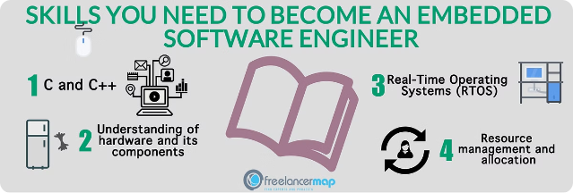
Conclusion: Career Opportunities in Embedded Systems
The embedded systems field offers a wide range of career opportunities, from software and hardware engineering to system architecture and analysis. As technology continues to evolve, the demand for skilled professionals in embedded systems will only grow, making it an exciting and rewarding field to explore.

